Slide 1
G2
Presentation
Jeff, Yoon Joo, Thao, Siti, Rose, DaEun

Slide 2
Table of Contents
01
02
05
03
06
04
07
Use Case
Conceptual Class
User Scenario Diagram
Class Diagram
Demo
Client Server Architecture
QnA
Notes:
The outline of our presentation.

Slide 3
01
Use Case
Use Case
Conceptual Classes
Client Server Archi
Class Diagram
User Scenario Diagram
Demo

Slide 4
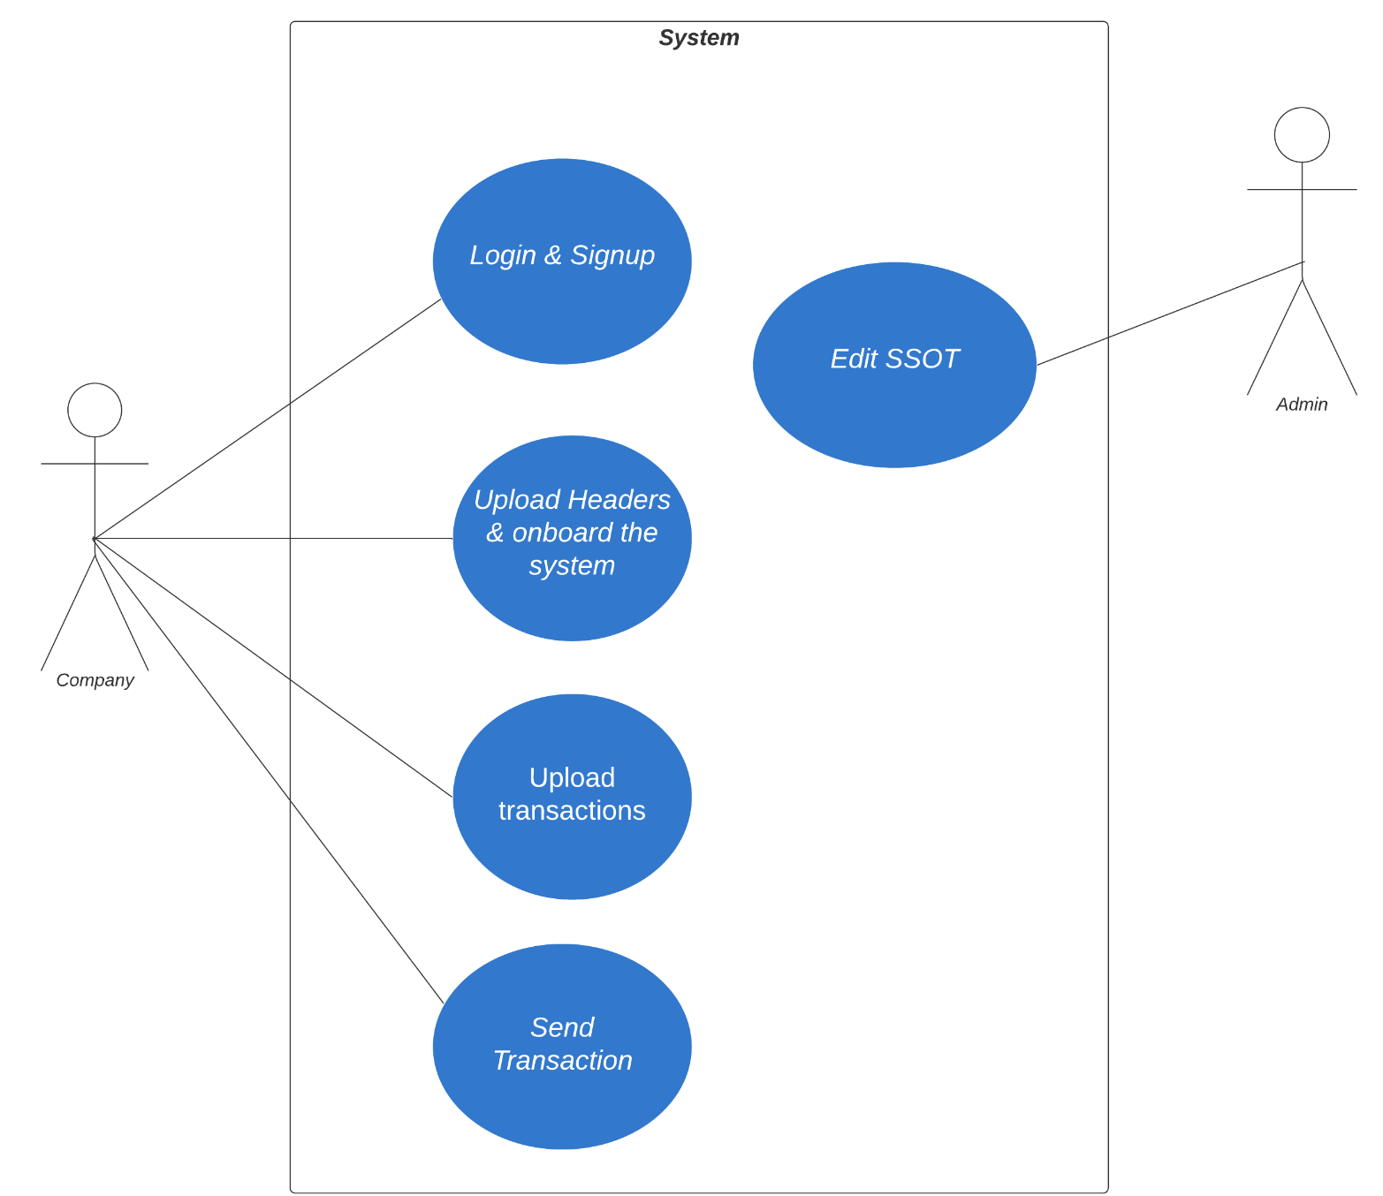
Notes:
To start off, here is our use case diagram that features the overview of our solution. It has two primary actors which are the client company and the admin. And their actions are as indicated in the blue circles.

Slide 5
02
Conceptual Classes
Use Case
Conceptual Classes
Client Server Archi
Class Diagram
User Scenario Diagram
Demo

Slide 6
Conceptual Classes
Sender
Ssot
Country
Receiver
Transaction
Role
Design Principle
SsotReceiverMap
SsotSenderMap
Pure Fabrication (GRASP):
SSOTSenderMap SSOTReceiverMap
Notes:
Moving on, here are the conceptual classes that we identified, which are….
Sender, ssot, receiver, transaction and country
[click animation]
For our solution, we decided to include SsotReceiverMap, SsotSenderMap classes and Role in addition to our domain classes. These 3 classes have specialised responsibilities which are not part of the domain concept and distinct from the Ssot or Sender or Receiver classes. This is where the design principle of pure fabrication applies. This helps to promote high cohesion whereby each component has only one primary well-defined purpose.

Slide 7
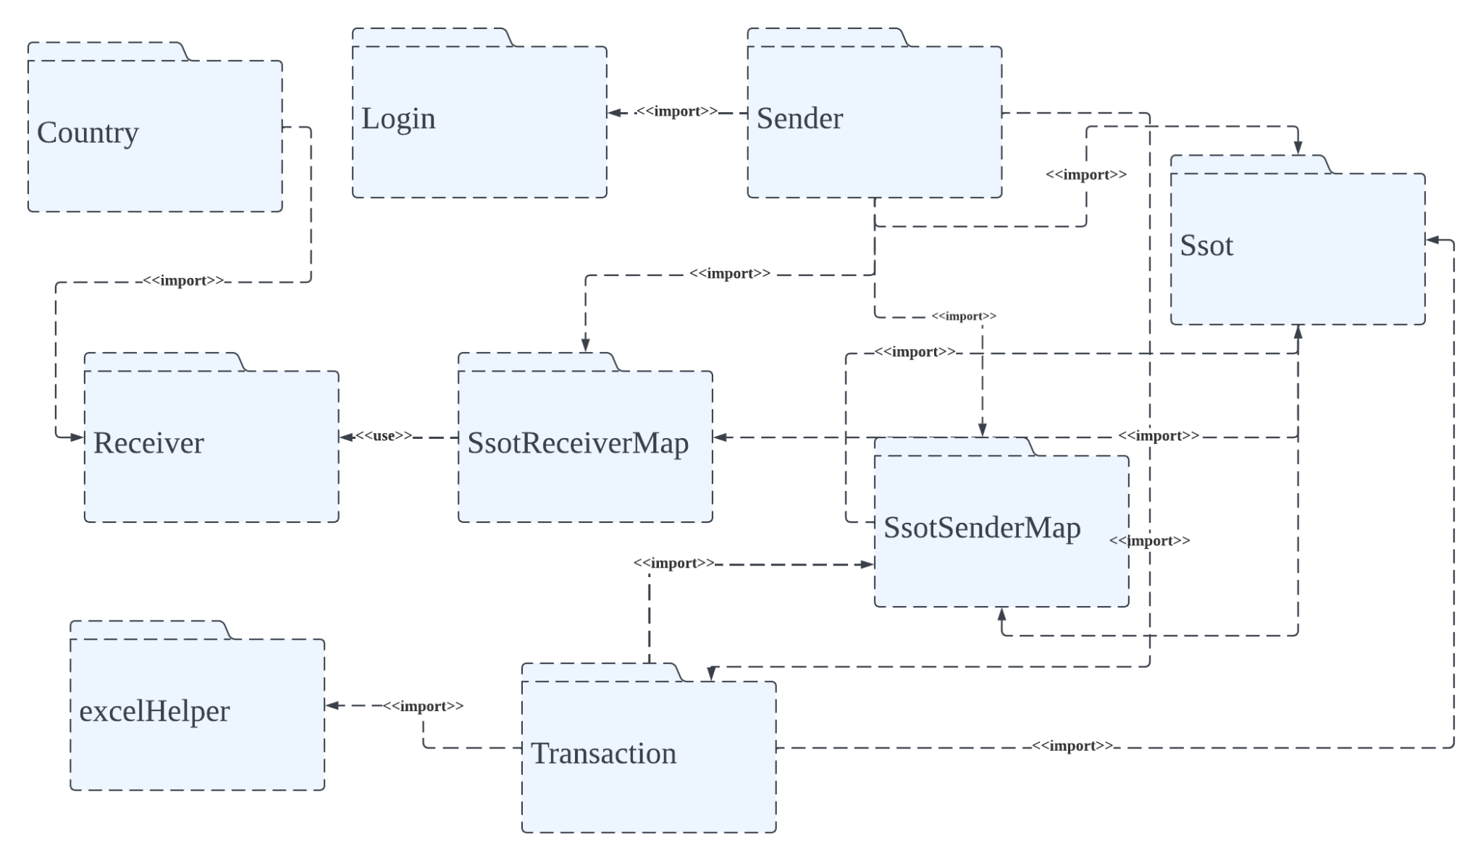
Package Diagram
Design Principle
Packaging by features:
Low coupling
High cohesion
Notes:
Next, this is how we packaged our code files which is as featured in this slide (to insert the diagram into a slide).
The reason why we packaged our files in this way is to ensure that most of the code that a feature needs are located within the package. This helps to avoid dependencies with other feature packages as much as possible. Hence, there is low coupling as it is less likely we disrupt other features while trying to change a feature.
Also, by packaging by feature, each component is well-defined which allows for high cohesion.

Slide 8
03
Class Diagram
Use Case
Conceptual Classes
Client Server Archi
Class Diagram
User Scenario Diagram
Demo

Slide 9
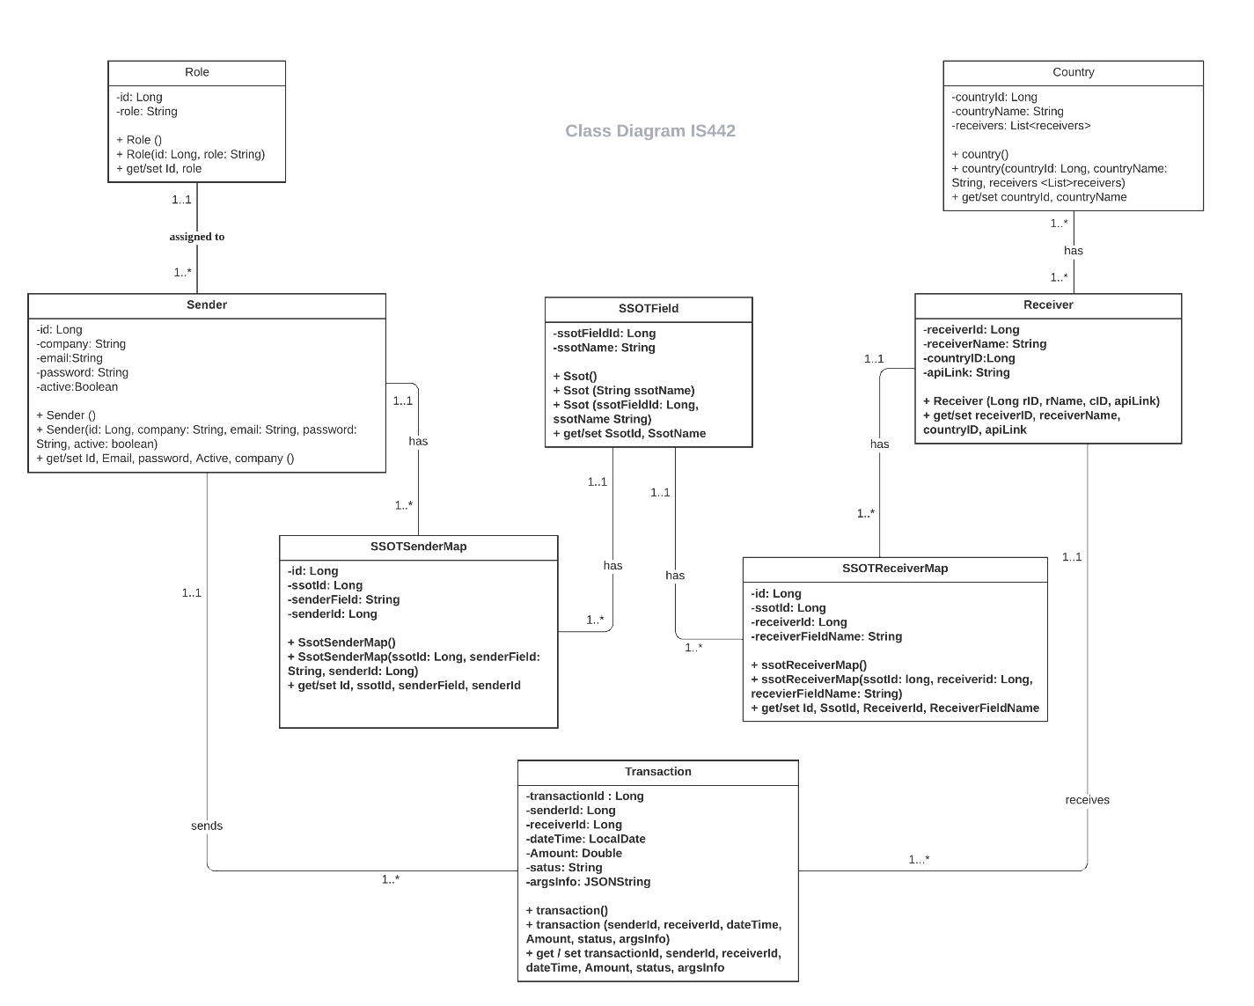
Class Diagram
Design Principle
Stereotyping (UML)
Notes:
Moving on to our class diagram, we will be showing how we stereotyped our classes and how we assigned responsibilities to them.

Slide 10
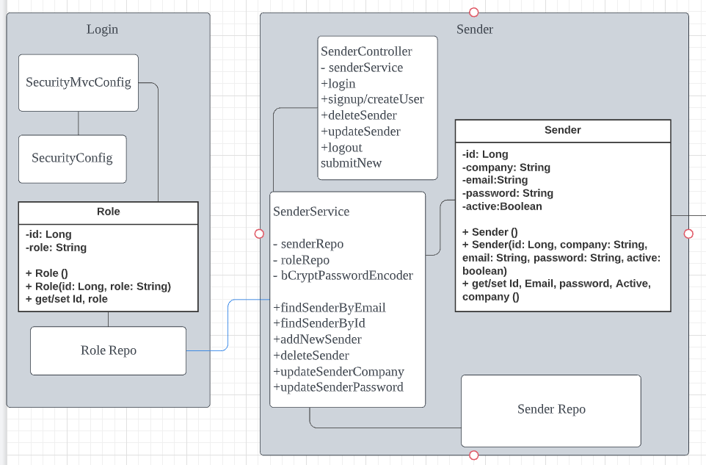
Role /
Sender
Class
Design
Principle
Expert
Notes:
Firstly, we have role class - which currently identifies user to be sender or admin.
Sender class represents one row of sender details in our database. Hence, by the expert principle, it is responsible for CRUD functions in the sender information.

Slide 11
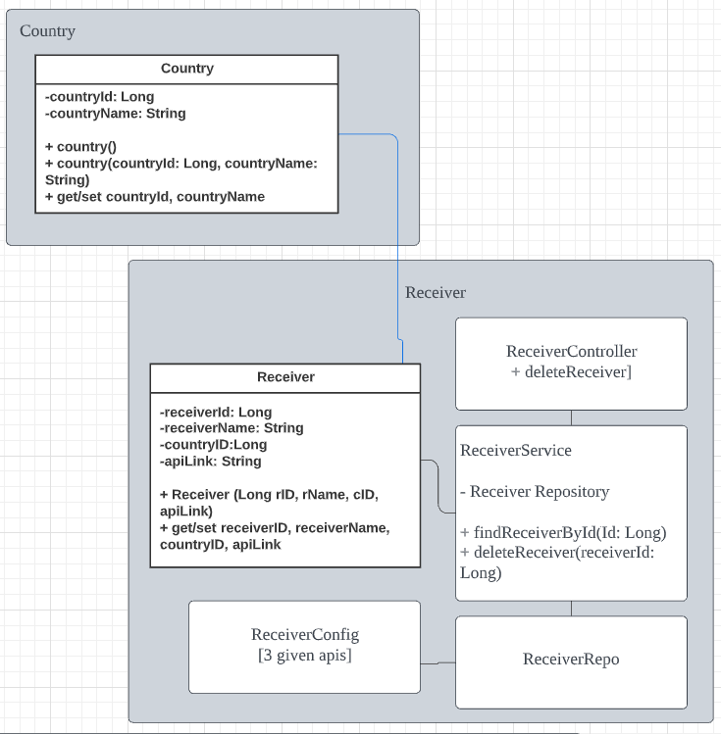
Receiver /
Country Class
Design Principle
Expert
Notes:
Similarly for receiver class
Additionally, receiver contains countryID which is linked to our country class.
Country class represents data for respective countries our company may serve beyond China in the future.

Slide 12
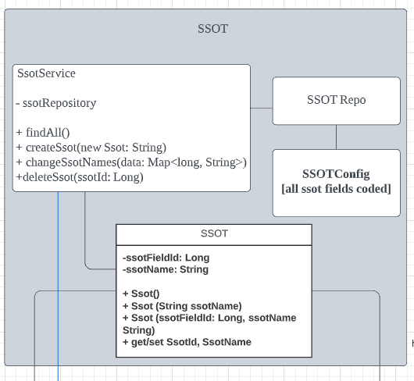
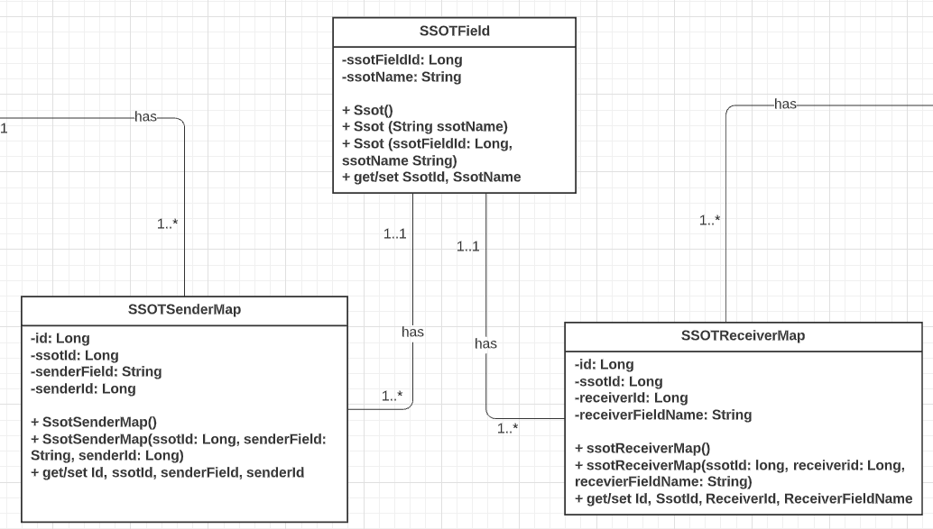
SSOTField
Modularisation of mapped fields
Design
Principle
Single Responsibility Principle
Open Closed Principle
Information hiding
Notes:
Moving on to SSOT Field. Each object of this class represents one SSOTField of our SSOT for the country. Responsible for CRUD functions of SSOT
This field is used by the SSOTFieldMap class and the SSOTReceiverMap class which each represents one field mapping of the Sender Field to the SSOT field, and Receiver field to the SSOT field. This closely abides to the single responsibility principle, where each class is only responsible for CRUDs of one single field.
Additionally it creates relationships between the Ssots and the SsotSenderMap and SsotReceiverMap - such that a Ssot object is deleted, it's dependent objects in SsotSenderMap and SsotReceiverMap are deleted as well
Such modularisation also further abides to the open closed principle - allowing our classes to be easily open for extension of more field values which affecting the other fields and closed for modification where information of other already well mapped fields are hidden and unaffected.

Slide 13
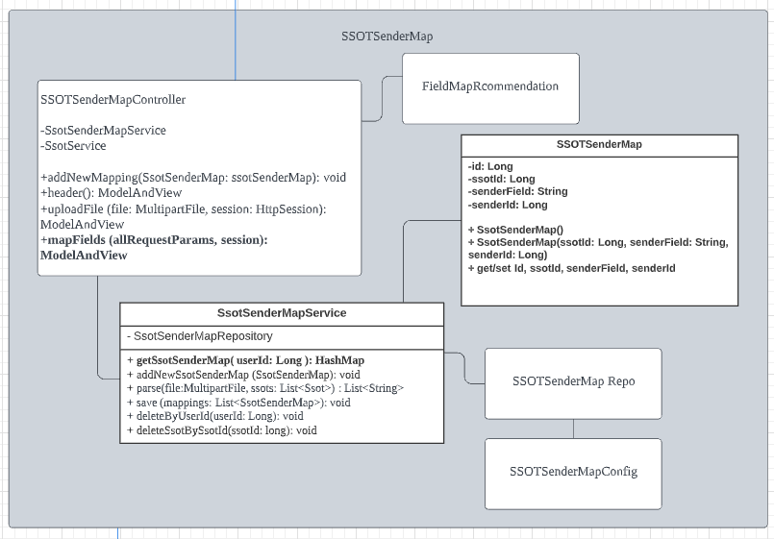
SSOTSenderMap
Responsibilities:
Map sender headers to SSOT
Design Principle
Pure Fabrication
Stereotyping: MVC
Notes:
As mentioned SSOT Sender Map class represents one field mapping between a single SSOT field to single sender field
created by pure fabrication following the MVC pattern - overall have responsibility to map sender headers to SSOT.
Pure fabrication: https://www.oreilly.com/library/view/applying-uml-and/0130925691/0130925691_ch22lev1sec3.html

Slide 14
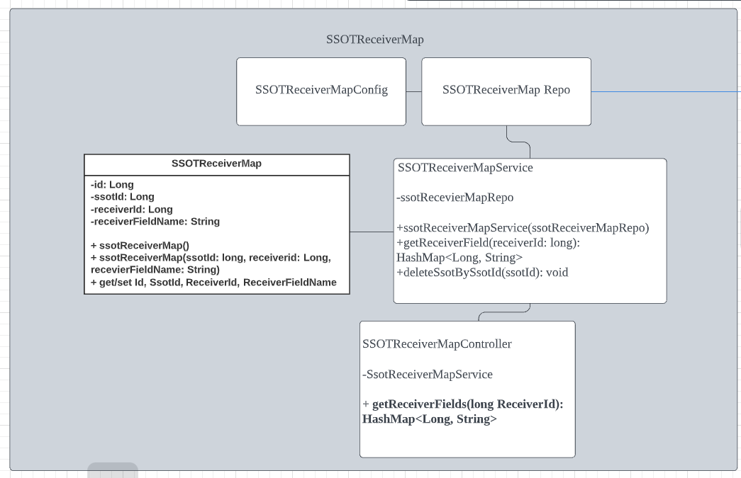
SSOTReceiverMap
Responsibilities:
Map receiver headers to SSOT
Design Principle
Pure Fabrication
Stereotyping: MVC
Notes:
Similarly for SSOT Receiver Map which has the main responsibility to map receiver headers to SSOT

Slide 15
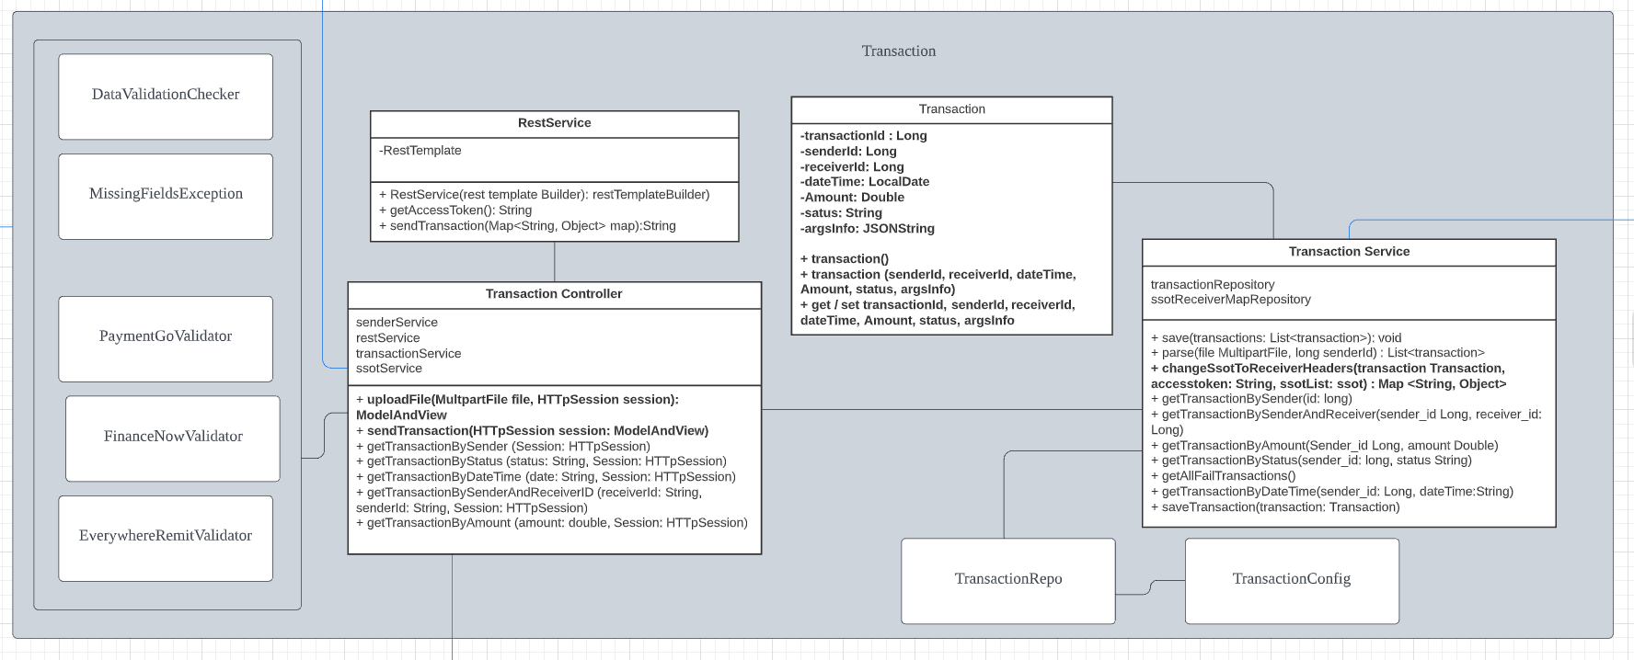
3. Transaction
Design Principle
Responsibilities:
Send Transactions
Validate values of transaction fields
Chain of responsibility:
Validation classes
Notes:
Transaction class represents the key information for our transaction as well as one row of transaction stored in JSONString.
This ensures that if there are any changes to number of SSOTs, transactions data stored in the JSONString will not be affected.
This class is mainly responsible for sending transaction and validating the fields.
Our validators also follow the chain of responsibility pattern - allowing easy addition of new validation rules from future onboarded receivers.
Chain of responsibility pattern - https://docs.microsoft.com/en-us/archive/msdn-magazine/2008/june/patterns-in-practice-the-open-closed-principle
Future plans: AmountChecker for Receiver APIs - as chain of responsibility

Slide 16
04
Client Server
Architecture
Use Case
Conceptual Classes
Client Server Archi
Class Diagram
User Scenario Diagram
Demo
Notes:
Next, here is the client-server architecture diagram of our solution.

Slide 17
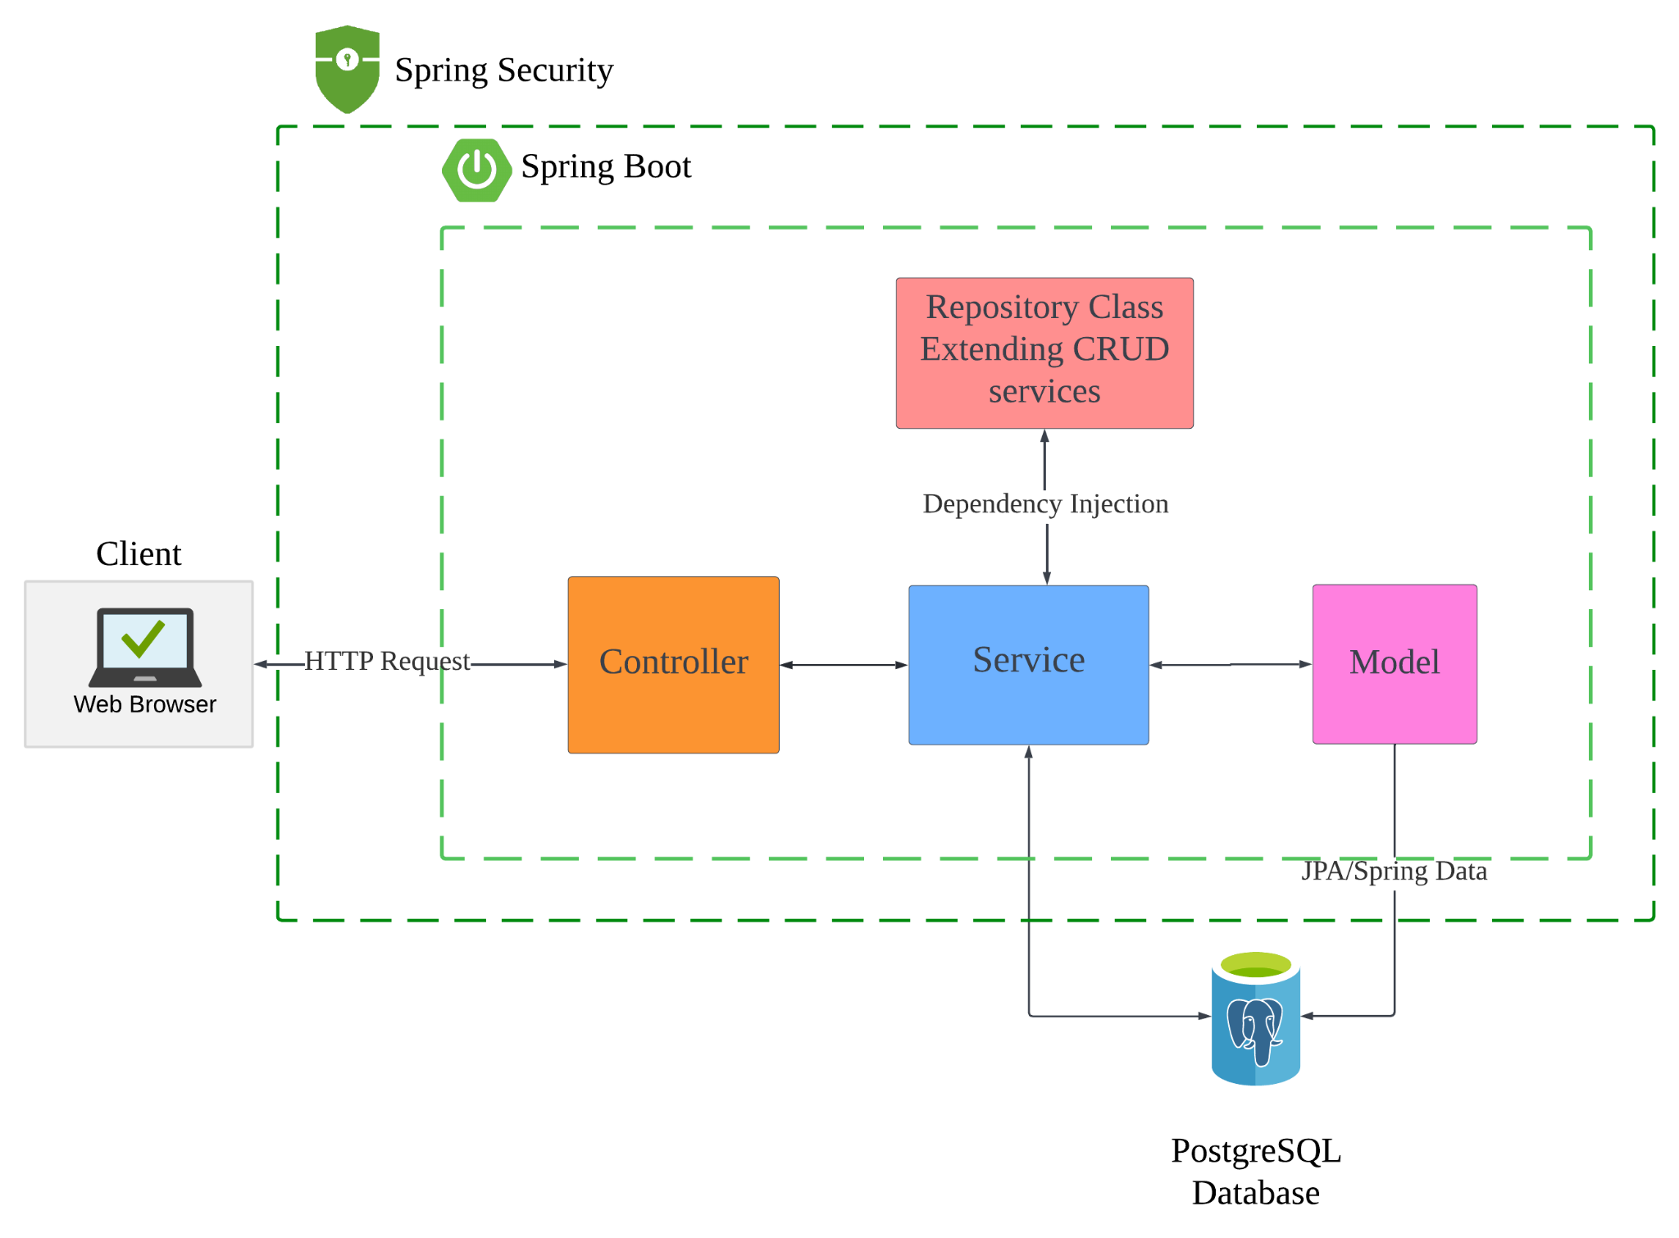
View
Controller
Model
Design Principle
Model-View-Controller (MVC) Architecture Pattern
Notes:
Next, here is the client-server architecture diagram of our solution.
Firstly, the client will make the HTTP request from the web browser. Then, the request goes to the controller. In the service layer, the business logic is done. The logic performed on the data is then mapped to JPA with model classes. The repository classes are involved in the data access layer whereby CRUD operations are performed.
Finally, the web page will then return the message based on the backend. For example, a message about whether the onboarding or submission of transaction data was successful.
This system architecture also links to the concept of MVC (click slide animation).
By using the MVC pattern, model, view and controller have separate functions and their interaction with one another is restricted. In this case, the service is the controller and the controller is the view.Model and view cannot be interacting with one another directly and controller will have to mediate the interaction.Since, there isn’t an apparent case where more than 1 component are dependent on each other from our MVC architecture, a component can be easily replaced without causing disruptions to many other components. This would mean low coupling.
On the other hand, each of the classes falls exactly under one of the MVC category: either model, view or controller. There are no overlaps. So, each of the components are well-defined and we are able to isolate the entire behaviour of our program into categories. Therefore, high cohesion.

Slide 18
05
User Scenario Diagram
Enter a subtitle here if you need it
Use Case
Conceptual Classes
Client Server Archi
Class Diagram
User Scenario Diagram
Demo
Notes:
Now i will be going through the user scenario diagram of the key scenarios and the details will be then subsequently be shown by Jeff during the demo

Slide 19

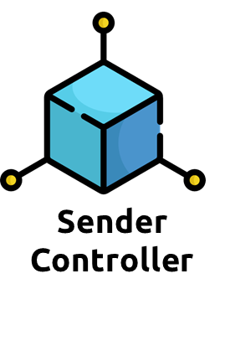
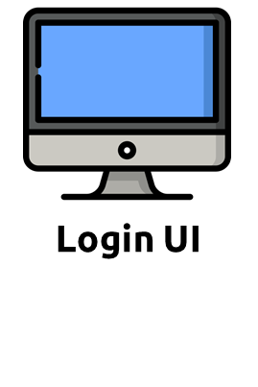

Login/Signup
2. Send email and password
1. Sign up/ login with email and password
3. Check if email already exists
5. Display success/ error message
4. Return authentication status
Notes:
The first is login where the user can either sign up for the first time or login with email and password via the login UI which subsequently sends email and password to sender controller to check if the email keyed in already exists.
Upon checking, sender controller will return the authentication status back to the login UI to display success or error message to the user.

Slide 20
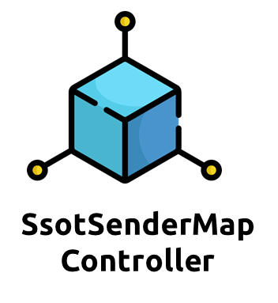

Upload Header
3. Checks if mapping already exists under user
4. Check if number of headers submitted is larger than number of SSOT fields
2. Send Sender Fields
1. Upload headers (Excel file)
6. Display success/ error message
5. Return upload status
7. Map fields to SSOT
8. Send mapping
11. Display mapping status
10. Send mapping status
9. Check if all the SSOT has a corresponding field
Notes:
Next we have upload header where the user uploads header as an excel file to the upload header UI
which subsequently sends sender fields to SsotSenderMap controller to check if the mapping already exists under the user and also check if number of headers submitted is larger than the number of ssot fields.
Upon checking, ssotsendermap controller will return the file upload status back to the login UI to display success or error message to the sender.
After the sender successfully uploads the header, they can map the sender fields to ssot and the mapping pair will be sent back to ssotsendermap controller which will check if all the SSOT has a corresponding field and finally send the mapping status back to the sender to be displayed as a success/error message.

Slide 21
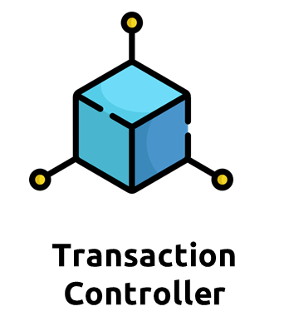
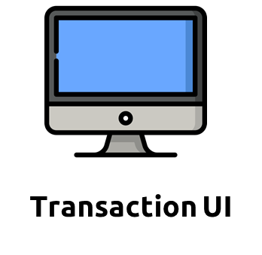
Upload Transaction
1. Upload Transaction (Excel file)
2. Send Transaction fields
4. Check for missing fields
5. Check for extra fields to be ignored
6. Map the transactions to SSOT fields
8. Display status
7. Return upload Status
Notes:
Next we have upload transaction where the user uploads transaction as an excel file to the transaction UI which subsequently sends sender transaction fields to Transaction controller
Here, the controller checks if there are missing fields and also check for extra fields to be ignored before finally mapping the transaction to SSOT fields. After this, transaction controller will return the upload status back to the transaction UI to display success or error message to the user.

Slide 22




Send Transaction
4. Checks the amount of transaction and selects the target API
5. Changes the headers to the target API’s headers
3. Send changeSsotReceiverHeader
request
2. Send transaction
1. Press “Send” button
6. Return hashmap of receiver headers and values
13. Display transaction status
7. Send transaction
12. Return transaction status
8. Validate data values
11. Return transaction status
10. Return transaction status
9. Send transaction
Notes:
Finally we have send transaction where the user presses send button via the transaction UI and subsequently sends the transaction to the transaction controller.
Here the controller sends changeSsotReceiverHeader request to the transaction service that checks the amount of transaction in order to select the target API and also change the ssot to the target API’s headers.
After this, the transaction service returns hashmap of receiver header and values back to transaction controller that sends the transaction to rest service that validates the data values. The Rest service then sends the transaction to the receiver which finally returns the transaction status all the way back to the transaction UI to be displayed to the sender. Now I will pass my time to jeff to go through the processes via the demo.

Slide 23
06
Demo
Enter a subtitle here if you need it

Slide 24
07
QnA

Slide 25
08
Additional Resources

Slide 26
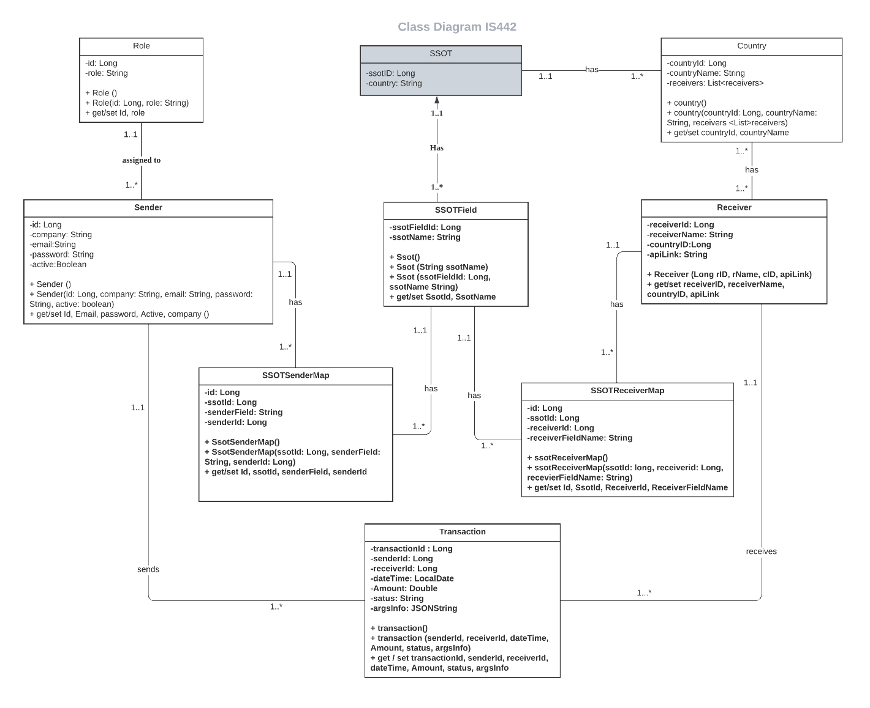

Slide 27
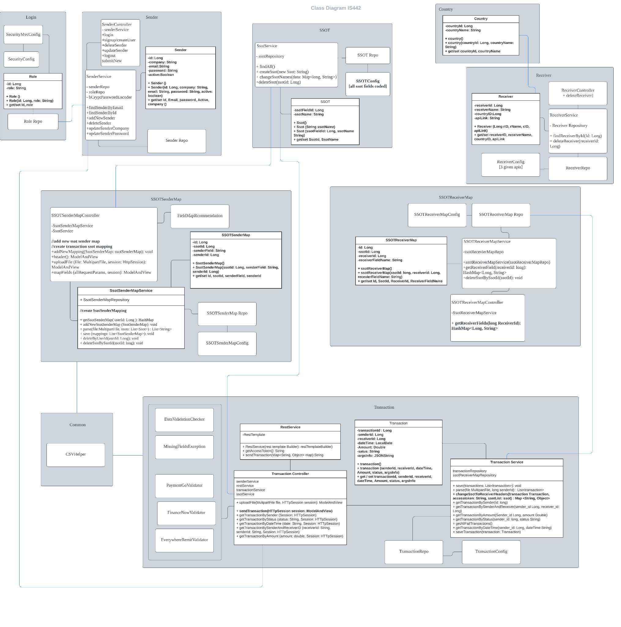

Slide 28
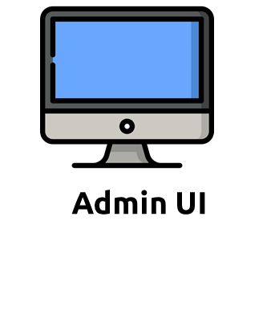
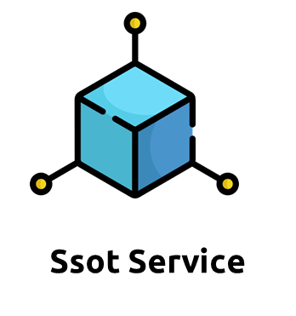
Admin - Edit SSOT
1.1 Enter new SSOT name
1.2 Select SSOT to be deleted
Send new SSOT name
2. Check if SSOT name already exists
3.1 If 2 true, display "Ssot already exists”
3.2 else, display “Ssot added successfully”
Display Ssot being successfully deleted
Return

Slide 29
Thank you!

